Slide 1
REACT
ADACODE SOLUTIONS

Slide 2
Difference between Angular and React
React | Angular
library | framework
one-way data binding | two-way data binding
Virtual DOM | Real DOM
JSX – JavaScript XML | Typescript
Facebook, Uber Technologies, Instagram, Netflix, Pinterest, etc. | Wepay, Beam, Auto Trader, Mesh, Streamline Social, etc

Slide 3
JSX
JSX stands for JavaScript XML.
JSX provides you to write HTML/XML then preprocessor will transform these expressions into actual JavaScript code.
Eg:
<div>Hello World</div>
Corresponding Output
React.createElement("div", null, "Hello World");

Slide 4
React.createElement Function
Every JSX is converted to the React.createElement function call that the browser understands.
Syntax:
type can be an HTML tag like h1, div or it can be a React component
props are the attributes you want the element to have
children contain other HTML tags or can be a component
React.createElement(type, [props], [...children])

Slide 5
Uses of JSX
It is faster than regular JavaScript because it performs optimization while translating the code to JavaScript.
Instead of separating technologies by putting markup and logic in separate files, React uses components that contain both.
It is type-safe, and most of the errors can be found at compilation time.
It makes easier to create templates.

Slide 6
Virtual DOM
It is like a lightweight copy of the actual DOM(a virtual representation of the DOM).
It does not have the power to directly change the layout of the document
The virtual DOM gets updated first instead of the real DOM.
When anything new is added to the application, a virtual DOM is created and it is represented as a tree.
Whenever there is a change in the state of any element, a new Virtual DOM tree is created.

Slide 7
Virtual DOM
New Virtual DOM tree is then compared with the previous Virtual DOM tree and make a note of the changes
After this, it finds the best possible ways to make these changes to the real DOM.
Now only the updated elements will get rendered on the page again.
This process of comparing the current Virtual DOM tree with the previous one is known as ‘diffing’.
The entire process of transforming changes to the real DOM is called Reconciliation

Slide 8
Components In React
Components are the building blocks of a React application.
They are reusable, self-contained pieces of code that encapsulate a part of the user interface (UI) and its behaviour.
React applications are typically composed of multiple components that work together to create a complete user interface.

Slide 9
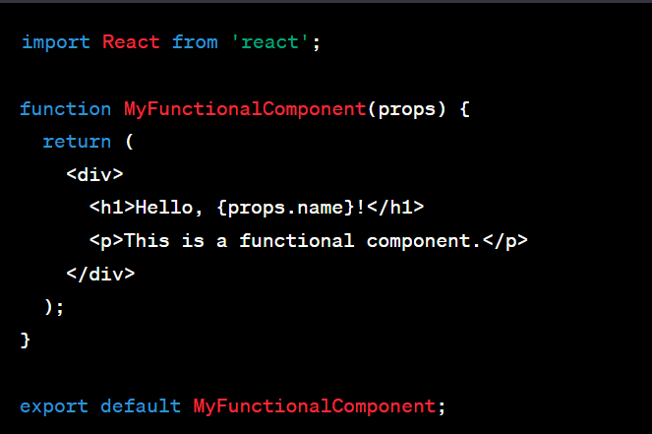
Functional Components (also known as Stateless Functional Components)
These are JavaScript functions that return JSX (JavaScript XML) to describe the UI.
Functional components are primarily used for representing the UI and rendering content.
They can also make use of React hooks to manage state and side effects.
Here's an example of a functional component:

Slide 10
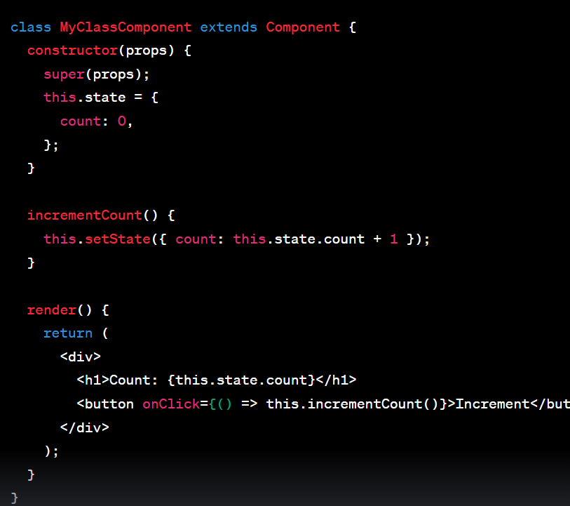
Class-based Components
These are JavaScript classes that extend React.Component and have more features compared to functional components.
Class-based components can manage their own state, implement lifecycle methods, and handle complex behavior.
However, with the introduction of React hooks, functional components have become more popular for managing state and side effects.
Here's an example of a class-based component:

Slide 11
State
State represents the value of a dynamic properties of a React component at a given instance.
A component can have its own state, which means it encapsulates some variables that other components can't access unless this component exposes this state to the rest of the application.
Whenever the state of the component is changed, the component will re-render itself by calling the render() method along with the new state.

Slide 12
Eg:
Components often need to change what’s on the screen as a result of an interaction. Typing into the form should update the input field, clicking “next” on an image carousel should change which image is displayed, clicking “buy” should put a product in the shopping cart. Components need to “remember” things: the current input value, the current image, the shopping cart. In React, this kind of component-specific memory is called state.

Slide 13
Adding a state variable
To add a state variable, import useState from React at the top of the file:
import { useState } from 'react';

Slide 14
Then, replace this line:
let index = 0;
with
const [index, setIndex] = useState(0);
The [ and ] syntax here is called array destructuring and it lets you read values from an array. The array returned by useState always has exactly two items.

Slide 15
Updating the Value of State
function handleClick() {
setIndex(index + 1);
}

Slide 16
Props
Props (short for properties) are a Component's configuration.
They are received from above and immutable as far as the Component receiving them is concerned.
A Component cannot change its props, but it is responsible for putting together the props of its child Components.
Props do not have to just be data -- callback functions may be passed in as props.

Slide 17
Changing props and state
props state
Can get initial value from parent Component? Yes Yes
Can be changed by parent Component? Yes No
Can set default values inside Component?* Yes Yes
Can change inside Component? No Yes
Can set initial value for child Components? Yes Yes
Can change in child Components? Yes No

Slide 18
State:
states are mutable(Can Change).
states are associated with the individual components can't be used by other components.
states are initialize on component mount.
states are used for rendering dynamic changes within component.
props:
props are immutable.
you can pass props between components.
props are mostly used to communicate between components.You can pass from parent to child directly. For passing from child to parent you need use concept of lifting up states.

Slide 19
Hooks
Hooks were introduced in React 16.8 and they let us use React’s features-like managing your component’s state and or performing an after effect when certain changes occur in state(s) without writing a class.

Slide 20
State Hooks
The React useState Hook allows us to track state in a function component.
State generally refers to data or properties that need to be tracking in an application
useState accepts an initial state and returns two values:
The current state.
A function that updates the state.

Slide 21
Tasks
Difference between Class based component and function based component
Function-based components have become the preferred choice for building React components in modern React development. Why?

Slide 22
Thank You

